Slide 1
MACOM Diode Products – NLTL Comb Generators rev 0
Joe Bukowski, Rick Cory
11 April 2017

Slide 2
Product Families
PIN/NIP Diodes:
Switching
Attenuation
Limiting
Varactor Diodes:
Tuning
Phase Shifting
Schottky Diodes:
Detection
Frequency Mixing
Diode Products
Attenuators
Multiplier Diodes:
Frequency Multiplication
Waveshaping
Passive Devices
RF Chokes/Inductors
MNS Capacitors
Resistors

Slide 3
Product Configurations
Packaged Solutions

Slide 4
Comb Generators
SRD
NLTL

Slide 5
Comb Generation
A comb generator produces even- and odd-order harmonics of an input signal
Comb generation requires a nonlinear impedance (NLZ) device to distort the input sinusoidal signal
Step recovery diodes (SRDs) have been used as NLZ devices
Varactor diodes are NLZ devices

Slide 6
Step Recovery Diode Comb Generators

Slide 7
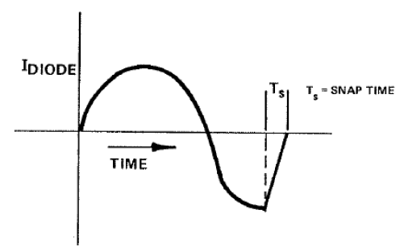
SRD Structure and Operation
An SRD is a 3-layer device, similar to PIN diode
Middle layer of SRD has higher n-type dopant concentration than I layer of PIN diode
Under forward bias, center layer stores charge
As input signal reverses polarity
Initially, charge is conducted from diode and its impedance remains low
When large majority of charge is removed, hole-electron recombination becomes dominant and diode “snaps off” (impedance transitions from very low to very high)
Howell, C.M., Selection of Multiplier Diodes, AN3023
SRD parameters
Carrier Lifetime (T_{L} or τ)
Transition time (T_{T})
AKA snap time (T_{S})
Junction capacitance (C_{J})
Reverse breakdown voltage (V_{B})

Slide 8
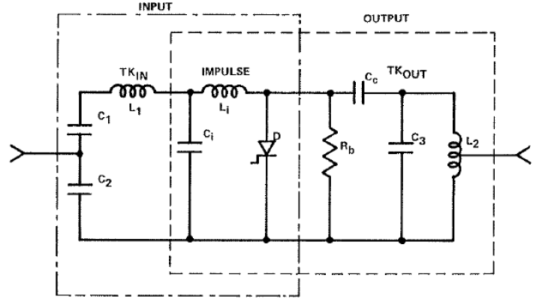
SRD Frequency Multiplier
Howell, C.M., Selection of Multiplier Diodes, AN3023
SRD frequency multiplier
Input Z match, LPF structure
SRD impulse generator
Output Z match, filter structure
SRD performance is highly wafer-lot-dependent
Performance is not amenable to simulation
SRD parameter selection
Carrier Lifetime (T_{L} or τ)
τ ≥ 10 x T_{fundamental}
Transition time (T_{T})
T_{T} << T_{harmonic}
Junction capacitance (C_{J})
X_{CJ} ≈ 50 Ω @ T_{harmonic}
Reverse breakdown voltage (V_{B})
V_{B} > V_{pk} @ fundamental frequency

Slide 9
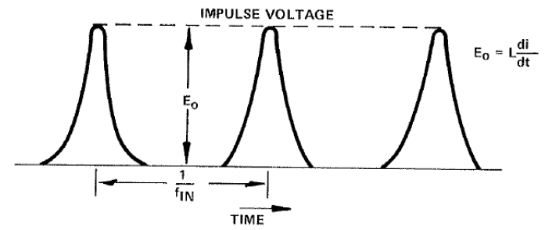
SRD Frequency Multiplier - Operation
Howell, C.M., Selection of Multiplier Diodes, AN3023
Low frequency input signal drives SRD into conduction during its positive alternation
Charge stored in the diode
While negative alternation conducts charge from diode its impedance remains low
When recombination dominates, the diode’s impedance rapidly goes from low to very high
This change causes the current through the inductor to (almost) instantaneously go to 0 A
Abrupt change in current through the inductor produces a (non-ideal), harmonic-rich voltage impulse

Slide 10
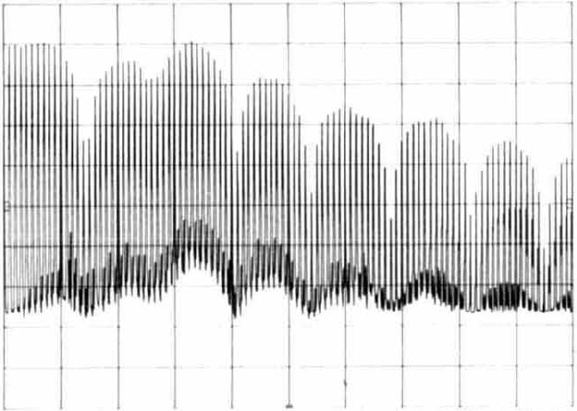
SRD Multiplier Performance
Difficult to design Z match circuit
In conduction, SRD impedance is approximately 5 to 10 Ω
After snap occurs, SRD impedance is very large and capacitive
Performance is highly dependent on input power
17 dBm ≤ P_{IN} ≤ 33 dBm
Output spectrum has sinx/x envelope
Output power ≈ fundamental input power/harmonic order
Recombination is inherently stochastic
Produces jitter in time domain → phase noise in frequency domain
Output Spectrum of SRD Comb Generator
A Simple Low Cost Comb Generator Frequency Calibrator, Martin, L, Ham Radio, July 1988

Slide 11
Nonlinear Transmission Line Comb Generators

Slide 12

MACOM Low Phase Noise Comb Generators
Low phase noise comb generator product line is based on Non-Linear-Transmission-Line (NLTL) technology.
Review: a single-impedance transmission line comprises a uniform value of inductance and capacitance per unit length
In a practical nonlinear transmission line, the fixed capacitance per unit length is replaced with a nonlinear capacitance
$$Z_{0}=\sqrt{\frac{L_{length}}{C_{length}}}$$

Slide 13
NLTL Comb Generator Composition
The MACOM family of NLTL comb generators utilize GaAs Schottky varactors diodes (STVARs)
Required doping profile of STVARs for NLTL comb generators is difficult to produce and must precisely meet requirements
Schottky diodes are utilized because they are majority carrier devices – no minority charge carrier storage can occur
The capacitance of the STVAR can change extremely rapidly (single picoseconds order of magnitude)
No shot noise is generated
Much less phase noise is produced

Slide 14
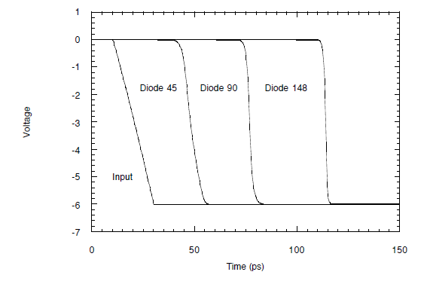
NLTL Operation
The velocity of propagation along the NLTL is a function of signal voltage due to the presence of the STVARs
Large signal voltage → small STVAR capacitance → fast velocity of propagation
Small signal voltage → large STVAR capacitance → slow velocity of propagation
Low voltage portion of incident pulse is increasingly delayed with respect to high voltage portion as the wave front propagates through the NLTL
Fourier analysis of resulting waveform shows spectrum rich in harmonics
Nonlinear Transmission Lines for Picosecond Pulse, Impulse and Millimeter-Wave Harmonic Generation, Case, M. G., PhD Thesis, UCSB, July 2, 1993

Slide 15
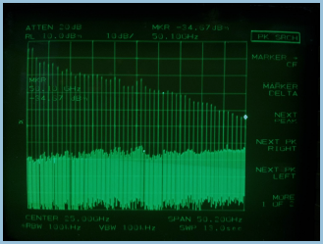
NLTL vs. SRD Comb Generator Output Spectrum
SRD Comb Generator
NLTL Comb Generator
Output Spectrum of SRD Comb Generator
Output Spectrum of NLTL Comb Generator
A Simple Low Cost Comb Generator Frequency Calibrator, Martin, L, Ham Radio, July 1988

Slide 16
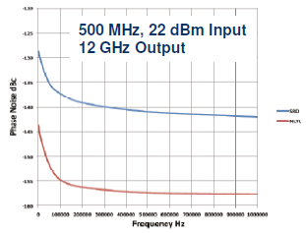
NLTL vs. SRD Comb Generator Phase Noise
Phase noise of NLTL comb generator as much as 15 dB lower than that of SRD comb generator

Slide 17
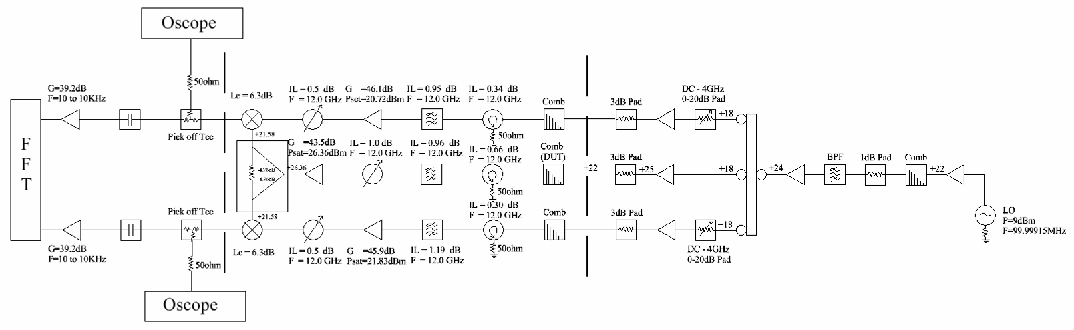
Cross-Correlated Interferometer Test System
Cross-correlation capable of removing uncorrelated noise due to mixers and post amplifiers
Uncorrelated noise reduced by 5Log(N) where N is the number of samples. 1000 samples lowers noise floor -15 dB.

Slide 18
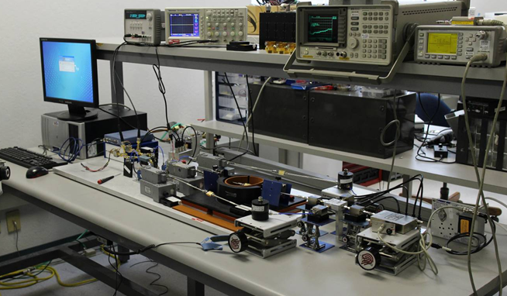
Cross-Correlation Phase Noise Test System

Slide 19
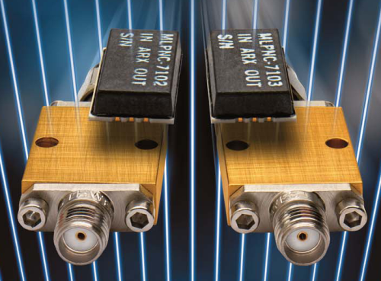
Non-Linear Transmission Line Comb Generators
NLTL Comb Generators offer key advantages relative to “typical SRD” products:
Lower phase noise – improved phase noise performance of multiplied source
Lower input power – reduced PA requirements and power consumption
Range of input frequency – enables use of single part in several designs or use with a tunable source (up to 3x instead of a few %)
Higher harmonic power at higher frequencies – SRD-based comb generators output power rapidly rolls off above 20 GHz
Reliable construction – based on monolithic circuits

Slide 20
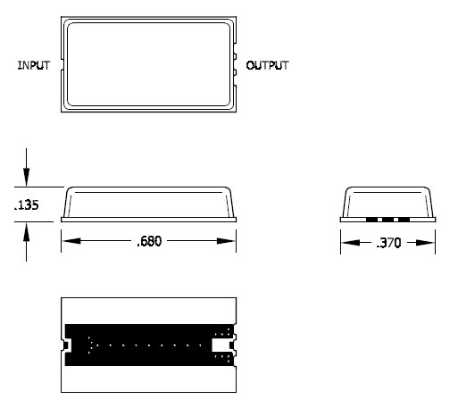
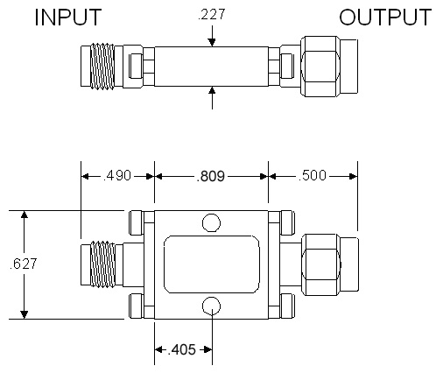
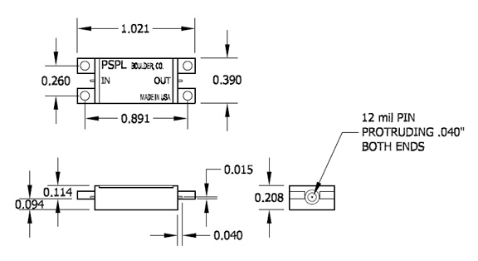
Package Outline Drawings

Slide 21
Thank You

